Slide 1
Creational Design Patterns

Slide 2
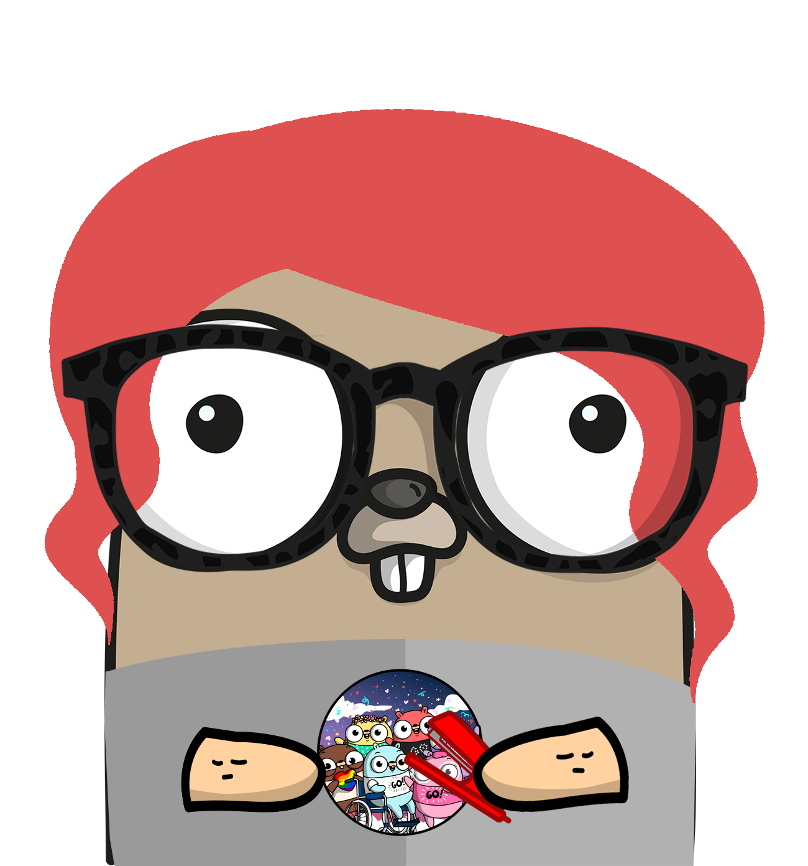
Olena Stoliarova,
Intermediate Go developer
TechnoRely

Slide 3
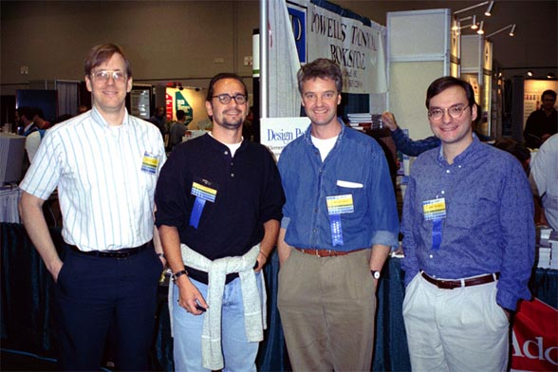
Gang of Four
or
How It All Began
In 1994, four authors Erich Gamma, Richard Helm, Ralph Johnson and John Vlissides published a book titled Design Patterns - Elements of Reusable Object-Oriented Software. They described 23 design patterns.
These patterns are divided into 3 big categories:
Creational patterns
Structural patterns
Behavioural patterns
Notes:
Design patterns represent the best practices used by experienced object-oriented software developers. Design patterns are solutions to general problems that software developers faced during software development. These solutions were obtained by trial and error by numerous software developers over quite a substantial period of time. What is Gang of Four (GOF)? In 1994, four authors Erich Gamma, Richard Helm, Ralph Johnson and John Vlissides published a book titled Design Patterns - Elements of Reusable Object-Oriented Software which initiated the concept of Design Pattern in Software development. These authors are collectively known as Gang of Four (GOF). According to these authors design patterns are primarily based on the following principles of object orientated design. Program to an interface not an implementation Favor object composition over inheritance

Slide 4

Reasons to learn design patterns
1. Make your life easier by not reinventing the wheel (and minimize the impact of change)
2. Improve your object-oriented skills
3. Recognize patterns in libraries and languages
4. Use the power of a shared vocabulary
5. Find truth and beauty
Eric Freeman and Elisabeth Robson, October 12, 2016
Notes:
https://www.oreilly.com/ideas/5-reasons-to-finally-learn-design-patterns
https://www.developer.com/design/article.php/1474561/What-Are-Design-Patterns-and-Do-I-Need-Them.htm
Understand and alter existing code without introduction of bugs

Slide 5
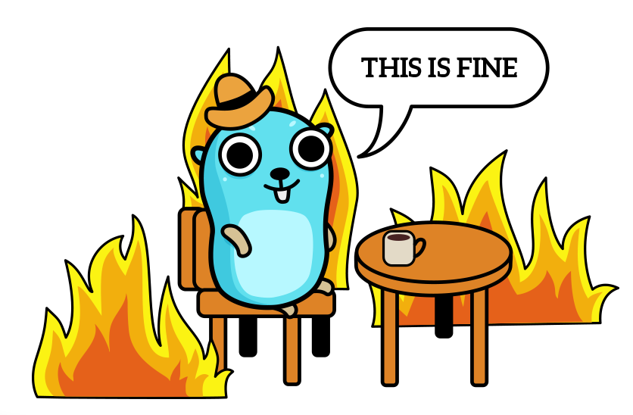
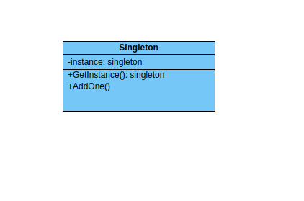
Overview
Singleton
Ensure that there is only one object of the type.
Single global point of access
Holds program state
Global variable can’t be a singleton (copyable)
Example: DB connection, SSH for several tasks
Notes:
https://medium.com/golang-issue/how-singleton-pattern-works-with-golang-2fdd61cd5a7f
The UML class diagram above describes an implementation of the singleton pattern. In this diagram the only public interface element is the static "GetSingleton" method. This method returns the single instance held in the private "instance" variable. Usually an instance of the class is created only when first requested. This lazy initialisation ensures that if the class is never required, resources are not wasted.

Slide 6
Singleton
Implementation
Protect initialization (for multi-threaded env)
type singleton struct {
count int
}
var instance *singleton
var once sync.Once
func GetInstance() *singleton {
if instance == nil {
once.Do(func() {
instance = new(singleton)
})
}
return instance
}
func (s *singleton) AddOne() int {
s.count++
return s.count
}

Slide 7
Singleton
Tests
func TestGetInstance(t *testing.T) {
counter1 := GetInstance()
if counter1 == nil {
t.Error("expected pointer, not nil")
return
}
expectedCounter := counter1
currentCount := counter1.AddOne()
if currentCount != 1 {
t.Errorf("after calling for the first time, the count must be 1 but equals %d\n", currentCount)
}
counter2 := GetInstance()
if counter2 != expectedCounter {
t.Error("expected same instance in counter2 but got a different instance")
}
currentCount = counter2.AddOne()
if currentCount != 2 {
t.Errorf("after calling 'AddOne' using the second counter, the current count must be 2 but was %d\n", currentCount)
}
}

Slide 8
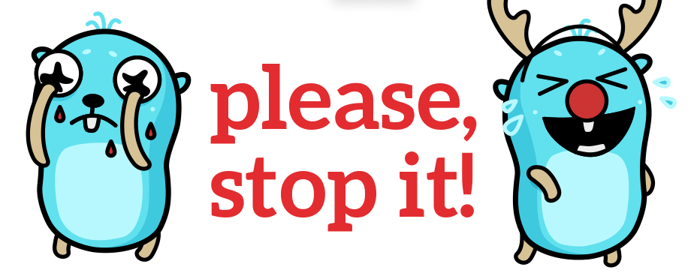
Singleton
Pros & Cons
Pros
Lazy initialization
Limit resource consumption
Cons
Hide dependencies
Hold state for the lifetime of the application and hinder writing independent unit tests

Slide 9
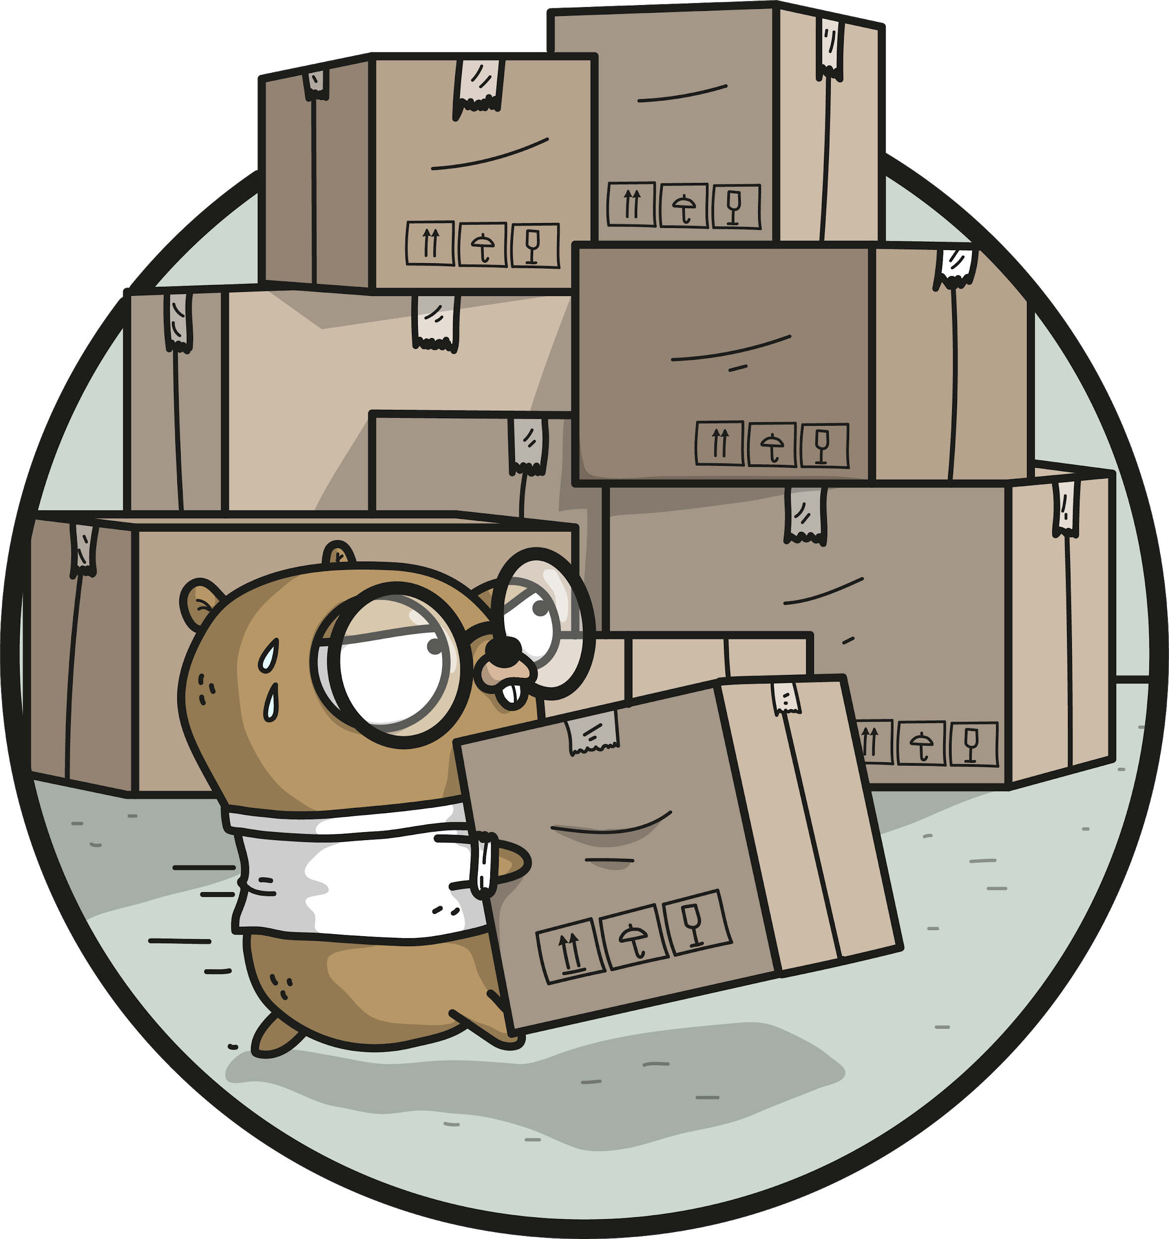
Builder
Overview
Provides flexible object creation. It is used when objects might have a number of fields, which can be optional or initialized/used in different order

Slide 10

Builder
Director, Product and BuildProcess Interface
type BuildProcess interface {
SetWheels() BuildProcess
SetSeats() BuildProcess
GetVehicle() VehicleProduct
}
type ManufacturingDirector struct {
builder BuildProcess
}
type VehicleProduct struct {
Wheels int
Seats int
}

Slide 11
Builder
Director, Product and BuildProcess Interface
func (f *ManufacturingDirector) Construct() {
f.builder.SetSeats().SetWheels()
}
func (f *ManufacturingDirector) SetBuilder(b BuildProcess) {
f.builder = b
}

Slide 12

Builder
Director, Product and BuildProcess Interface
type CarBuilder struct {
v VehicleProduct
}
func (c *CarBuilder) SetWheels() BuildProcess {
c.v.Wheels = 4
return c
}
func (c *CarBuilder) SetSeats() BuildProcess {
c.v.Seats = 5
return c
}
func (c *CarBuilder) GetVehicle() VehicleProduct {
return c.v
}

Slide 13
Builder
Tests
func TestBuilderPattern(t *testing.T) {
manufacturingComplex := ManufacturingDirector{}
carBuilder := &CarBuilder{}
manufacturingComplex.SetBuilder(carBuilder)
manufacturingComplex.Construct()
car := carBuilder.GetVehicle()
if car.Wheels != 4 {
t.Errorf("wheels on a car must be 4 and they were %d\n", car.Wheels)
}
if car.Seats != 5 {
t.Errorf("seats on a car must be 5 and they were %d\n", car.Seats)
}
}

Slide 14

Builder
Pros and Cons
Pros:
Internal representation of methods (building blocks) can be different
Create (embedded) objects step by step
Reuse creation algorithm
Cons:
Implement ConcreteBuilder for each type of object
Algorithms should be defined in advance. If a method is added to an interface, other implementations must be changed correspondingly

Slide 15
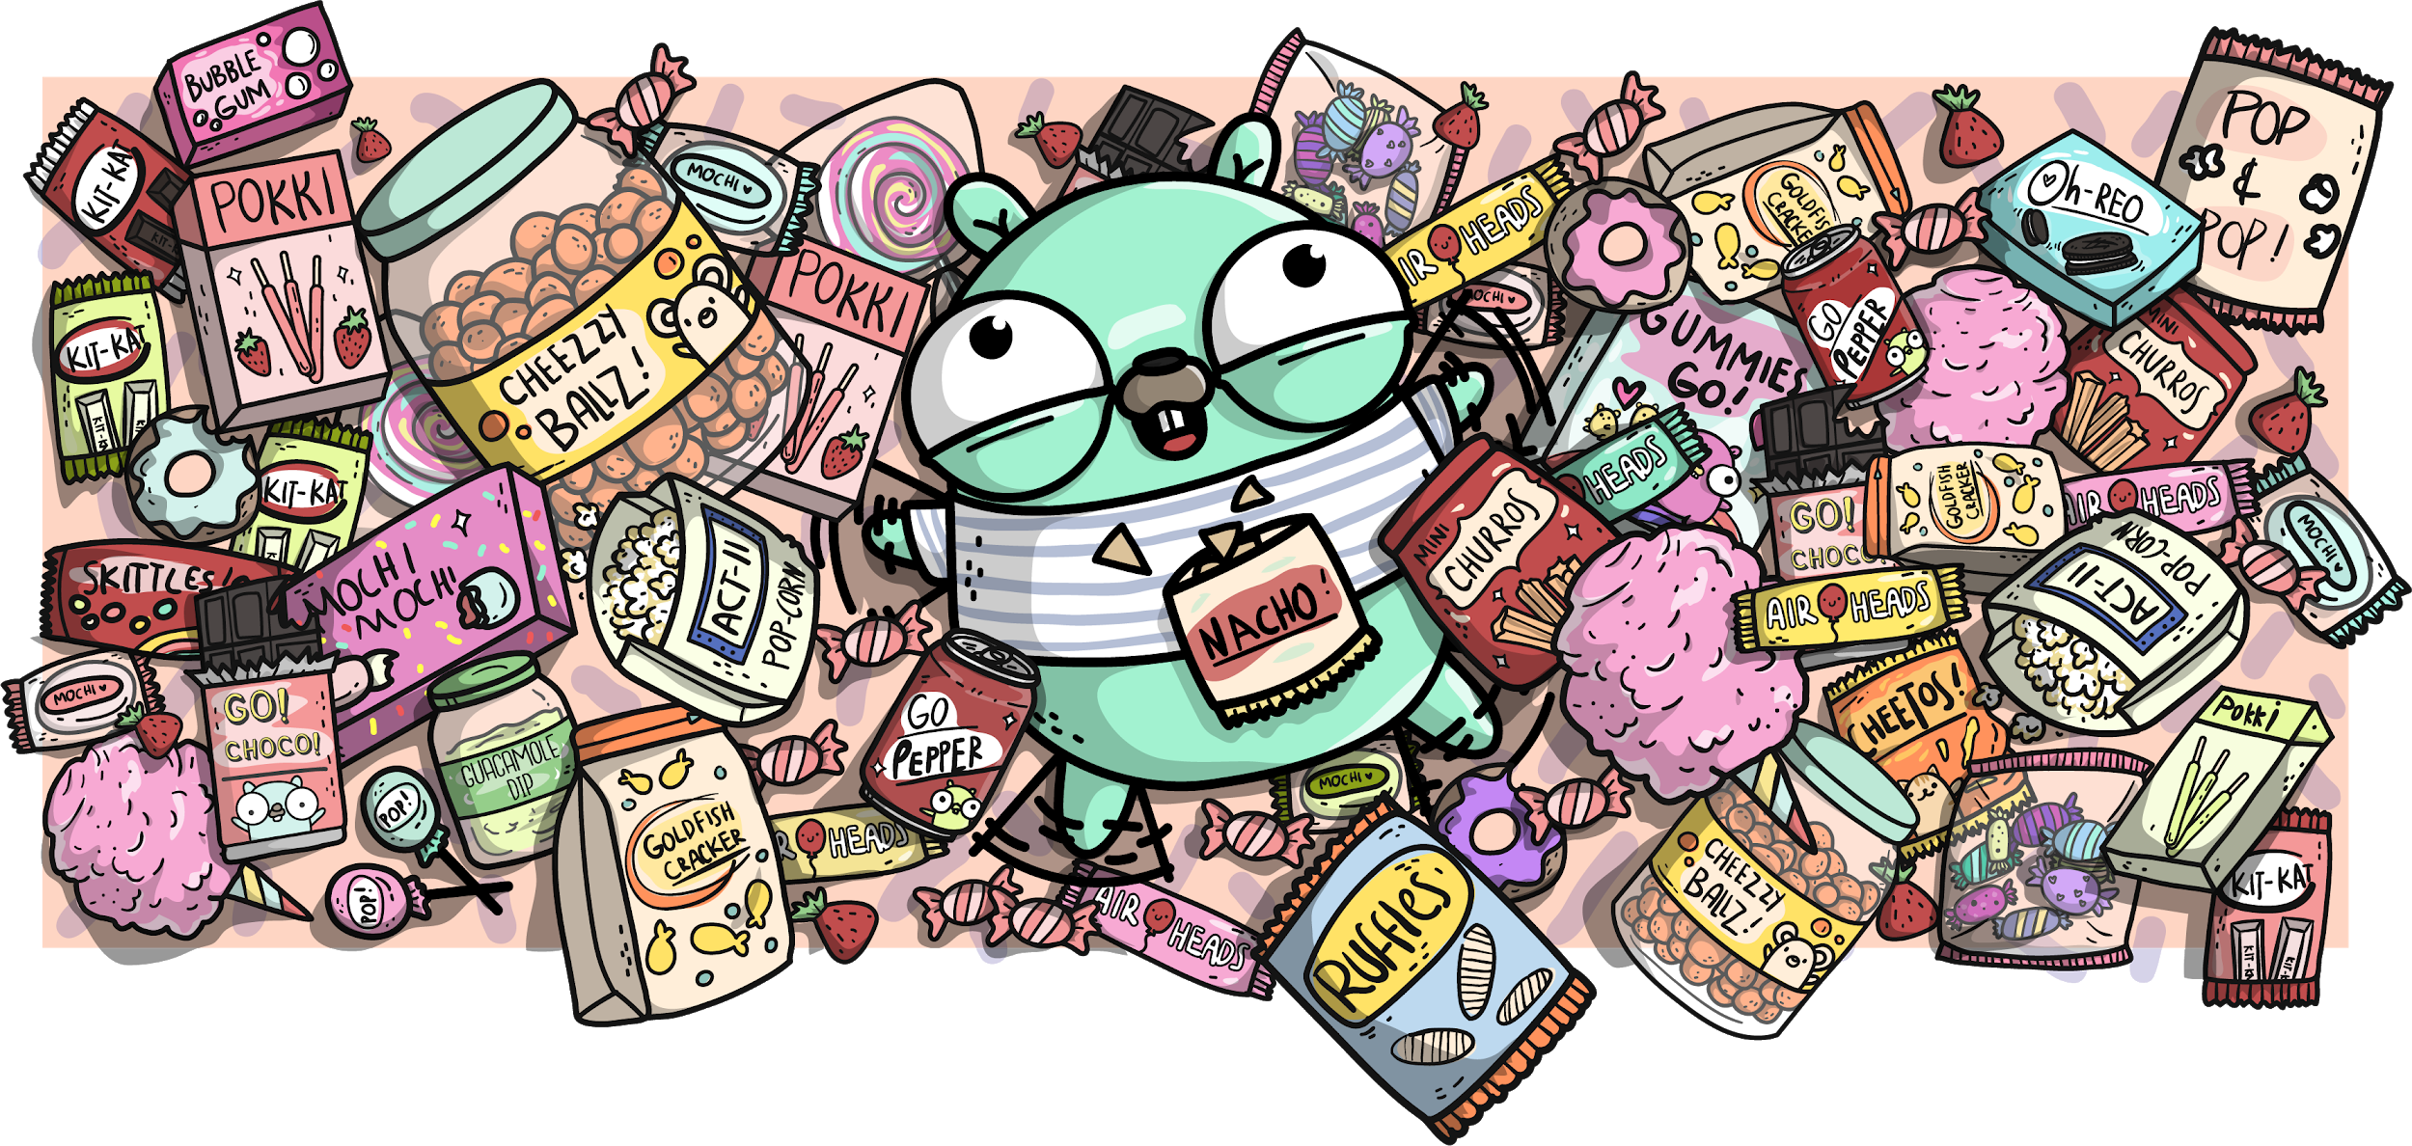
Factory method
Overview
Provides flexible object creation. It is used when objects can have a number of fields, which can be optional or initialized/used in different order

Slide 16

Factory method
Implementation
type PaymentMethod interface {
Pay(amount float32) string
}
func GetPaymentMethod(m string) (PaymentMethod, error) {
switch m {
case “Cash”:
return new(CashPM), nil
default:
return nil, errors.New(fmt.Sprintf("payment method %d not recognized", m))
}
}
type CashPM struct{}
func (c *CashPM) Pay(amount float32) string {
return fmt.Sprintf("%0.2f payed using cash", amount)
}

Slide 17
Factory method
Tests
func TestGetPaymentMethodCash(t *testing.T) {
payment, err := GetPaymentMethod(Cash)
if err != nil {
t.Fatal("a payment method of type 'Cash' must exist")
}
msg := payment.Pay(10.30)
if !strings.Contains(msg, "paid using cash") {
t.Error("incorrect cash payment method message")
}
}

Slide 18
Factory method
Pros and Cons
Pros:
Work on interface level: integrated apps won’t be affected by implementation changes
Easy to extend by adding more implementations
Cons:
If factory ‘products’ have variations, you either need to add all these options to the Factory (cluttering) or separate this to different factories (cluttering again)

Slide 19

Abstract Factory
Overview
Interface for interchangeable factories that allows integrating them into a ‘superfactory’

Slide 20
Abstract Factory
Implementation
type VehicleFactory interface {
GetVehicle(v int) (Vehicle, error)
}
const CarFactoryType = 1
func GetVehicleFactory(f int) (VehicleFactory, error) {
switch f {
case CarFactoryType:
return new(CarFactory), nil
default:
return nil, errors.New(fmt.Sprintf("factory with id %d not recognized\n", f))
}
}

Slide 21
Abstract Factory
Implementation
const LuxuryCarType = 1
const FamilyCarType = 2
type CarFactory struct{}
func (c *CarFactory) GetVehicle(v int) (Vehicle, error) {
switch v {
case LuxuryCarType:
return new(LuxuryCar), nil
case FamilyCarType:
return new(FamilyCar), nil
default:
return nil, errors.New(fmt.Sprintf("vehicle of type %d not recognized\n", v))
}
}

Slide 22

Abstract Factory
Implementation
type LuxuryCar struct{}
func (l *LuxuryCar) GetDoors() int {
return 4
}
func (l *LuxuryCar) GetWheels() int {
return 4
}
func (l *LuxuryCar) GetSeats() int {
return 5
}

Slide 23
Abstract Factory
Tests
func TestCarFactory(t *testing.T) {
carF, err := GetVehicleFactory(CarFactoryType)
if err != nil {
t.Fatal(err)
}
carVehicle, err := carF.GetVehicle(LuxuryCarType)
if err != nil {
t.Fatal(err)
}
t.Logf("car vehicle has %d seats and %d wheels\n", carVehicle.GetSeats(), carVehicle.GetWheels())
luxuryCar, ok := carVehicle.(Car)
if !ok {
t.Fatal("struct assertion has failed")
}
t.Logf("luxury car has %d doors.\n", luxuryCar.GetDoors())
}

Slide 24
Abstract Factory
Pros and Cons
Pros:
Factory products are compatible
Respecting single responsibility principle
Possible to extend without breaking (introduce new options of products)
Cons:
Necessary to support multiple interfaces and the code can become overcomplicated

Slide 25
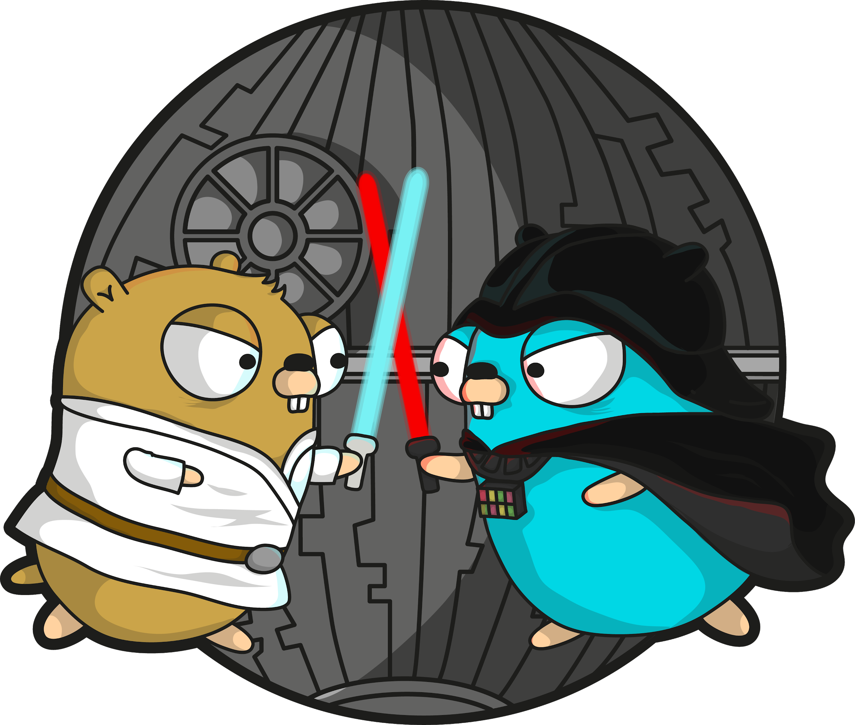
Prototype
Overview
Using already created instance of some type to clone it and complete it for particular needs

Slide 26
Prototype
Implementation
type Shirt struct {
Price float32
Color string
}
var whitePrototype = &Shirt{
Price: 15.00,
Color: White,
}
type ShirtCloner interface {
GetClone(s string) (ItemInfoGetter, error)
}
type ShirtsCache struct{}
func GetShirtsCloner() ShirtCloner {
return new(ShirtsCache)
}

Slide 27
Prototype
Implementation
func (sc *ShirtsCache) GetClone(s string) (ItemInfoGetter, error) {
switch s {
case "White":
newItem := *whitePrototype
return &newItem, nil
default:
return nil, errors.New("shirt model not recognized")
}
}
type ItemInfoGetter interface {
GetInfo() string
}
func (s *Shirt) GetInfo() string {
return fmt.Sprintf("shirt with color id %d that costs%f\n", s.Color, s.Price)
}
func (i *Shirt) GetPrice() float32 {
return i.Price
}

Slide 28
Prototype
Tests
func TestClone(t *testing.T) {
shirtCache := GetShirtsCloner()
if shirtCache == nil {...}
item1, err := shirtCache.GetClone(“White”)
if err != nil {...}
if item1 == whitePrototype {
t.Error("item1 cannot be equal to the white prototype")
}
shirt1.Price = 23.5
item2, err := shirtCache.GetClone(White)
if err != nil {...}
if shirt1.Price == shirt2.Price {
t.Error("prices of shirt1 and shirt2 must be different")
}
if shirt1 == shirt2 {
t.Error("shirt1 cannot be equal to shirt2")
}
}

Slide 29

Prototype
Pros and Cons
Pros:
Creates objects at compilation time
Objects have a default value
Free CPU of complex object initialization
Cons:
Cloning complex objects might be tricky

Slide 30
“ Code is like humor. When you have to explain it, it’s bad.” – Cory House

Slide 31
Materials
I used various sources to prepare these slides and talk. The most helpful was a book Go Design Patterns by Mario Castello Contreras and github examples accompanying this book.
Other links are sited in speaker notes to the slides where this information is used.
If there are any copyright issues, please contact me and I’ll remove/change corresponding slides or indicate your authorship.
These slides can be used for free for educational purposes and are not intended to make financial profit.

